Slide 1
IEEE 802.15.4 - SubG IIoT in the Making
Florian Grandel, fgrandel@code-for-humans.de

Slide 2
agenda
|- net/
|- ieee802154/……………………………………………
|- api/……………………………………………………
|- cc13xx_cc26xx_subg……
|- tsch/………………………………………
|- time/……………………………………………………………
|- ranging/………………………………………………………………
$> questions, feedback, collaboration
state, opportunities, roadmap
extensibility, dev experience
fixes, stability, timed tx
precision timing in action
distributed clocks
outlook on uwb hrp and fira

Slide 3
IEEE 802.15.4 Subsystem state, opportunities, roadmap
Florian Grandel, fgrandel@code-for-humans.de

Slide 4


current state: protocols
capabilities
tdoa / aoa
timing
uwb
phys
subg
2.4g
tx/rx/cca/ed
application
home
industrial
indoor nav
Notes:
complexity of drivers and available capabilities/applications increases along three dimensions
The native L2 stack supports basic custom protocols with 6LoWPAN
The OT stack supports Thread 1.3 - which includes CSL (therefore timing req)

Slide 5






current state: drivers
capabilities
tdoa / aoa
timing
uwb
phys
subg
2.4g
tx/rx/cca/ed
protocols
home
industrial
indoor nav
Notes:
Only one driver is currently capable to support CSL for Thread
Most drivers support basic 2.4g custom protocols, two SubG drivers - TI now extensively tested, one UWB - but basic TX/RX support only, timed TX theor. available but not well tested

Slide 6
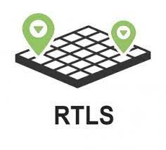

opportunities: iiot, rtls, …?
capabilities
tdoa / aoa
timing
uwb
phys
subg
2.4g
tx/rx/cca/ed
protocols
home
industrial
indoor nav
Notes:
IIoT
expand to industrial users, requires slotted/deterministic wireless protocols and SubG support
unlocks wireless TSN use cases - including 5G/6G DetNet support
Ranging
very attractive use case, driven by adoption in the mobile and car lock market (mobile / Zephyr interop similarly to BLE)
features far beyond existing solutions like BLE direction finding or , security, true ranging, not just AoA as BLE, true impulse response/los path detection)
many potential additional use cases both for home and industrial markets - whenever mobility is involved (door locks, warehouse management, find my cat, hospital alarms, …)

Slide 7


roadmap: 6tisch, fira, …?
capabilities
tdoa / aoa
timing
uwb
phys
subg
2.4g
tx/rx/cca/ed
protocols
home
industrial
indoor nav
Notes:
TSCH
TDMA and frequency hopping protocol
provides deterministic RX/TX times
very sophisticated scheduling and QoS (link period, overlapping slotframes) much beyond other options in the standard (BE-PAN/DSME/CSL)
specifically designed for IIoT - contender to WirelessHART
The IETFs recommended protocol for DetNet applications over IEEE 802.15.4
Contiki has it but lacks Zephyr’s power of execution
FiRa
Fully IEEE 802.15.4z compliant
Additional upper layer protocols
Apple, Samsung, Google support - many vendors (NXP, MicroChip, qorvo)
Zephyr could be the first free RTOS to support FiRa

Slide 8
IEEE 802.15.4 L2/Driver API extensibility and dev experience
Florian Grandel, fgrandel@code-for-humans.de

Slide 9
extensibility: DGRAM/RAW sockets
/* Create and Bind Socket */
int fd = socket (AF_PACKET, SOCK_DGRAM, ETH_P_IEEE802154);
struct sockaddr_ll sll = {
.sll_ifindex = net_if_get_by_iface(iface), .sll_family = AF_PACKET, .sll_protocol = ETH_P_IEEE802154
};
bind(fd, (const struct sockaddr *)&sll, sizeof(struct sockaddr_ll));
/* Sending */
sendto(fd, payload, payload_len, 0, (const struct sockaddr *)&dst, sizeof(struct sockaddr_ll));
/* Receiving */
struct timeval timeo_optval = { .tv sec = 1, .tv usec = 0 };
setsockopt(fd, SOL SOCKET, SO RCVTIMEO, &timeo_optval, sizeof(timeo_optval));
recvfrom(fd, buf, len, 0, (struct sockaddr *)&src, &src_len);

Slide 10
extensibility: DGRAM/RAW sockets
/* Create and Bind Socket */
int fd = socket (AF_PACKET, SOCK_DGRAM, ETH_P_IEEE802154);
struct sockaddr_ll sll = {
.sll_ifindex = net_if_get_by_iface(iface), .sll_family = AF_PACKET, .sll_protocol = ETH_P_IEEE802154
};
bind(fd, (const struct sockaddr *)&sll, sizeof(struct sockaddr_ll));
/* Sending */
sendto(fd, payload, payload_len, 0, (const struct sockaddr *)&dst, sizeof(struct sockaddr_ll));
/* Receiving */
struct timeval timeo_optval = { .tv sec = 1, .tv usec = 0 };
setsockopt(fd, SOL SOCKET, SO RCVTIMEO, &timeo_optval, sizeof(timeo_optval));
recvfrom(fd, buf, len, 0, (struct sockaddr *)&src, &src_len);

Slide 11
extensibility: DGRAM/RAW sockets
/* Create and Bind Socket */
int fd = socket (AF_PACKET, SOCK_DGRAM, ETH_P_IEEE802154);
struct sockaddr_ll sll = {
.sll_ifindex = net_if_get_by_iface(iface), .sll_family = AF_PACKET, .sll_protocol = ETH_P_IEEE802154
};
bind(fd, (const struct sockaddr *)&sll, sizeof(struct sockaddr_ll));
/* Sending */
sendto(fd, payload, payload_len, 0, (const struct sockaddr *)&dst, sizeof(struct sockaddr_ll));
/* Receiving */
struct timeval timeo_optval = { .tv sec = 1, .tv usec = 0 };
setsockopt(fd, SOL SOCKET, SO RCVTIMEO, &timeo_optval, sizeof(timeo_optval));
recvfrom(fd, buf, len, 0, (struct sockaddr *)&src, &src_len);

Slide 12
extensibility: all channel pages
switch (ieee802154_radio_current_channel_page(iface)) {
case IEEE802154_ATTR_PHY_CHANNEL_PAGE_ZERO_OQPSK_2450_BPSK_868_915:
return (channel >= 11
? IEEE802154_PHY_OQPSK_780_TO_2450MHZ_SYMBOL_PERIOD_NS
: (channel > 0 ? IEEE802154_PHY_BPSK_915MHZ_SYMBOL_PERIOD_NS
: IEEE802154_PHY_BPSK_868MHZ_SYMBOL_PERIOD_NS));
case IEEE802154_ATTR_PHY_CHANNEL_PAGE_TWO_OQPSK_868_915:
return (channel > 0 ? IEEE802154_PHY_OQPSK_780_TO_2450MHZ_SYMBOL_PERIOD_NS
: IEEE802154_PHY_0QPSK_868MHZ_SYMBOL_PERIOD_NS);
case IEEE802154_ATTR_PHY_CHANNEL_PAGE_FOUR_HRP_UWB: {
struct ieee802154_attr_value value;
ieee802154_radio_attr_get(iface, IEEE802154_ATTR_PHY_HRP_UWB_SUPPORTED_PRFS, &value));
switch (value.phy_hrp_uwb_prf) {
case IEEE802154_PHY_HRP_UWB_NOMINAL_4_M:
return IEEE802154_PHY_HRP_UWB_PRF4_TPSYM_SYMBOL_PERIOD_NS;
case IEEE802154_PHY_HRP_UWB_NOMINAL_16_M:
return IEEE802154_PHY_HRP_UWB_PRF16_TPSYM_SYMBOL_PERIOD_NS;
case IEEE802154_PHY_HRP_UWB_NOMINAL_64_M:
return IEEE802154_PHY_HRP_UWB_PRF64_TPSYM_SYMBOL_PERIOD_NS;
default:
return IEEE802154_PHY_HRP_UWB_ERDEV_TPSYM_SYMBOL_PERIOD_NS;
}
}

Slide 13
summary: standard compliance
net: ieee802154: decouple ieee802154 l2 from l3 (IP)
precondition for DGRAM support: #48586, #48719, #48751
net: ieee802154: support DGRAM/RAW sockets (kudos: wpan-tools!)
#49311
net: ieee802154: unlock advanced PHYs
#61413 (channel pages/ranges)
net: ieee802154: make the API vendor and protocol agnostic
RFC: #61227, PRs/Issues: #58434 (kconfig), #62940 (enh-ack), #62918 (csl, synchronization), #59133 (RSSI in dbm), #62995 (“ot sleep” -> “rx off”), #60401/#60946/#61430 (ns/sfd timestamps, ot docs)
Ready for IIoT/TSCH and ranging. Contributions welcome!

Slide 14
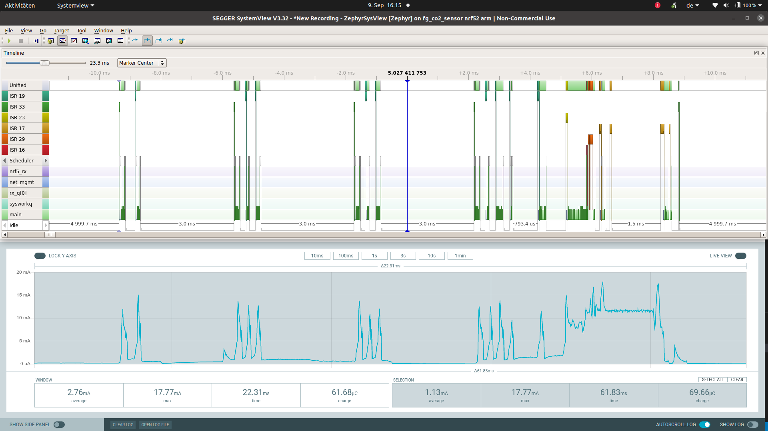
dev experience: tracing/power
Credits: SEGGER SystemView under non-commercial/OSS license (above), Nordic Power Profiler Kit II - PPK2 (below)
Notes:
sample from nRF5 but now also works in IEEE 802154 generally and for CC13/26xx (RTT and trace integration fixes)
wip: tracing resolution for SEGGER SystemView no longer tied to kernel clock (32k only for nRF5 / TI)
wip: ieee802154 tracing module for SEGGER SystemView

Slide 15
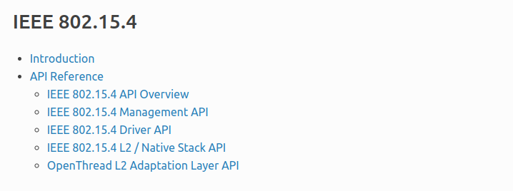
dev experience: docs
https://docs.zephyrproject.org/latest/connectivity/networking/api/ieee802154.html
A full set of API and conceptual documentation.
Notes:
sample from nRF5 but now also works in IEEE 802154 generally and for CC13/26xx (RTT and trace integration fixes)
wip: tracing resolution for SEGGER SystemView no longer tied to kernel clock (32k only for nRF5 / TI)
wip: ieee802154 tracing module for SEGGER SystemView

Slide 16
summary: dev experience
net: ieee802154: fixed bit rot and protocol bugs in native l2
#48716, #50400, #51261, #51263, #51264, #51265, #51266, #58068, #58191, #58438, #59906, #62409, #63256
net: ieee802154: improved test coverage
#53764, #58059, #58068, #60120, #60300
net: ieee802154: extensive api documentation
#51541, #62503
drivers: ieee802154: fix tracing/rtt/zperf for a an improved debugging experience
#50110, #59123, #59142, #61090, #61487

Slide 17
challenge: vendor/user adoption
vendor commitment is crucial (see Nordic)
other vendors reluctant - pulled in by user demand?
what increases adoption?
Ideas, blog posts, samples and real-world applications welcome!
Notes:
now that we’re ready for IIoT prime time - how can we make it a real-world success?
traditional market approach challenged by Zephyr (in ieee802154 largely due to Nordic)
vendors with traditional market approach reluctant: proprietary sdks and blobs for user lock in

Slide 18
TI CC13xx SubG tested, fixed, iiot ready
Florian Grandel, fgrandel@code-for-humans.de
Notes:
In addition to 2.4G, SubG is very important for IIoT use cases (band usage, range, channel availability, application-specific tweaking of PHY parameters in industry-specific SUN PHY…)

Slide 19
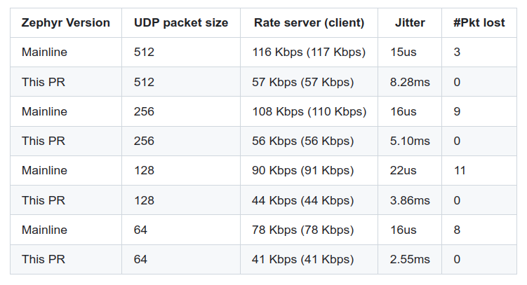

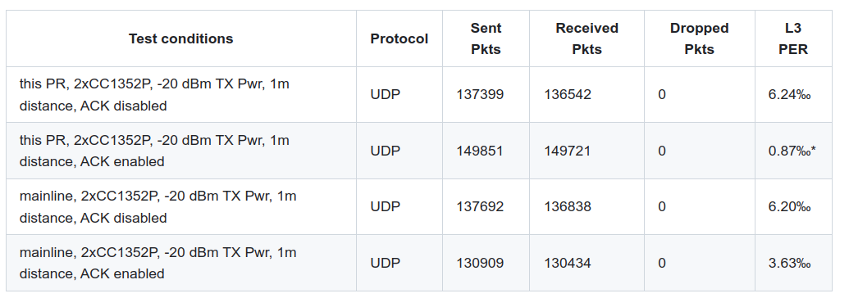
driver fixes: PER and Timing
Fixed CSMA/CA backoff.
Reduced PER due to ACK fix.
Notes:
You’ll say “Hey but that’s a regression” -> No, it’s CSMA/CA in action - ALOHA is now faster than before
ACK didn’t work at all due to a combination of L2 and driver bugs.
Details/PR links on my summary slide for later reference.

Slide 20
summary: ti cc13xx subg stability
modules: hal: ti: fix upstream driver bugs
#62435 (power down race, ~17.250 ppm conversion error)
drivers: ieee802154: stability and standard compliance
#58439 (fix PHY settings, P/R type connections, extensive echo/zperf tests), #63255 (improved locking)
drivers: ieee802154: support scheduled tx/rx, precise rx timestamps
wip, based on precision distributed clock framework, uses RF_multiMode command queue
IIoT/TSCH will be fully supported on TI CC13/26xx SubG platform.

Slide 21
driver challenges (beyond nRF/TI)
testability and test coverage
OpenThread support beyond nRF5
driver updates for timed TX
Additional collaborators and contributions welcome!

Slide 22
TSCH + Net Time precision timing in action
Florian Grandel, fgrandel@code-for-humans.de

Slide 23
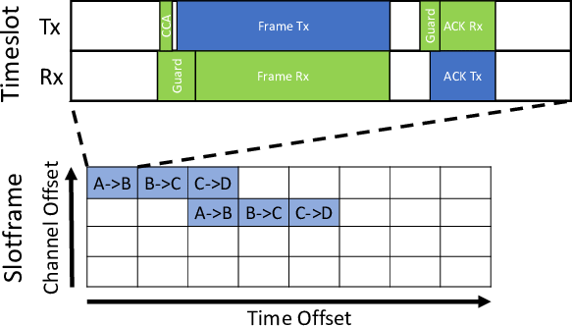
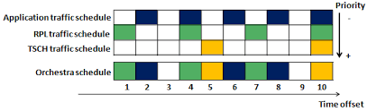
theory: tsch slot operation
Source: Duquennoy, Simon & Elsts, Atis & Al Nahas, Beshr & Oikonomou, George. (2017). TSCH and 6TiSCH for Contiki: Challenges, Design and Evaluation. 10.1109/DCOSS.2017.29.
Source: Sana Rekik, Nouha Baccour, Mohamed Jmaiel, Khalil Drira. A Performance Analysis of Orchestra Scheduling for TSCH networks. Internet Technology Letters, 2017, 1 (3), ff10.1002/itl2.4ff. ffhal01575098.
Notes:
The publication by Duquennou et al is a good read in any case. Co-author Atis Elsts is actively counseling the Zephyr TSCH effort.
above
TS -> TDMA, see horizontal axis
CH -> frequency diversity/channel hopping, see vertical axis
below
QoS due to overlapping schedules and link frequency
Practical example hospital alarm system - emergency button -> rtls -> non-regulated convenience functions

Slide 24
practice: tsch slot operation (wip)
Test slotframe
RX slot
TX frame
vertical lines: calculated/expected
Zoom
1µs
Notes:
above: slotframe timing (length of slots, offsets, etc. can be individually tuned, this shows part of a slotframe with standard subG slot timing template)
below:
theoretical max - 250ns RAT tick, i.e. ¼ of the 1us division,
TI driver now allows to achieve this theoretical limit deterministically due to the precision time framework (we talk about that later on) and measured characterization

Slide 25
code sample: scheduled TX
case IEEE802154_TX_MODE_TXTIME: {
const struct net_time_reference_api *time_api =
ieee802154_cc13xx_cc26xx_net_time_reference_api_get();
/* Convert the network-wide distributed syntonized time
* representation to a TI driver specific RAT value.
*/
drv_data->cmd_prop_tx_adv.startTrigger.triggerType = TRIG_ABSTIME;
if (net_time_reference_get_tick_from_time(
time_api,
net_pkt_timestamp_ns(pkt) + TX_START_TIME_OFFSET_NS,
NET_TIME_ROUNDING_NEAREST_TIMEPOINT,
(void *)&drv_data->cmd_prop_tx_adv.startTime)) {
return -EIO;
}
break;

Slide 26
code sample: scheduled RX
/* Start of RX slot. */
drv_data->cmd_prop_rx_adv.startTrigger.triggerType = TRIG_ABSTIME;
if (net_time_reference_get_tick_from_time(
time_api,
drv_data->rx_slot.start + RX_START_TIME_OFFSET_NS,
NET_TIME_ROUNDING_PREVIOUS_TIMEPOINT,
(void *)&drv_data->cmd_prop_rx_adv.startTime)) {
return -EIO;
}
/* End of RX slot. */
drv_data->cmd_prop_rx_adv.endTrigger.triggerType = TRIG_ABSTIME;
if (net_time_reference_get_tick_from_time(
time_api,
drv_data->rx_slot.start + drv_data->rx_slot.duration + RX_END_TIME_OFFSET_NS,
NET_TIME_ROUNDING_NEXT_TIMEPOINT,
(void *)&drv_data->cmd_prop_rx_adv.endTime)) {
return -EIO;
}

Slide 27
net: time: concepts
Abstract Clock Subsystem (RFC: #19030, comment)
counter / clocksource layer
overflow protection, low-power, high resolution, uint64_t tick-level precision, low-level sync, PPS device support
syntonization layer (RFC: #60400)
multi-instance, ns drift compensation, distributed clocks, multiplexed timers, precision timestamps
timescale layer
epoch/offset handling, synchronization (aka “servos”), leap seconds, system clock integration
clients
posix, libc, applications

Slide 28
code sample: clocksource API
/* simplified: removed fn and api pointers */
struct net_time_counter_api {
int init(struct net_if *iface);
int get_current_timepoint(k_timepoint_t *timepoint);
void get_tick_from_timepoint(k_timepoint_t timepoint, void *tick);
void get_timepoint_from_tick(void *tick, k_timepoint_t *timepoint);
void timer_start(struct k_timer *timer, k_timeout_t duration,
k_timeout_t period);
void timer_stop(struct k_timer *timer);
int wake_up();
int may_sleep();
const struct k_timeout_api timeout_api;
const uint32_t frequency;
};

Slide 29
code sample: distributed clock API
/* simplified: removed fn and api pointers */
struct net_time_reference_api {
int init(struct net_if *iface);
int get_time(net_time_t *uptime);
int get_time_from_timepoint(k_timepoint_t timepoint, net_time_t *net_time);
int get_timepoint_from_time(net_time_t net_time, enum net_time_rounding rounding, k_timepoint_t *timepoint);
int timer_start(struct net_time_timer *timer, net_time_t expire_at, net_time_t period,
enum net_time_rounding rounding, net_time_t *programmed_expiry);
int timer_stop(struct net_time_timer *timer);
int syntonize(net_time_t net_time, k_timepoint_t timepoint);
int get uncertainty(net_time_t target_time, net_time_t *uncertainty);
const struct net_time_counter_api *counter_api;
};

Slide 30
ns-precision time: opportunities
unlocks protocols BE-PANs/DSME/CSL, automation, 15.4z ranging
precise system clock POSIX clocks, timescales, leap second management, …
distribute time with GNSS/PTP precision distributed transactions, 5G/6G TSN
pluggable re-use of complex algorithms
What can be improved? What else can we do with this?

Slide 31
Outlook: UWB Ranging
Contributions Welcome!
Florian Grandel, fgrandel@code-for-humans.de

Slide 32
Questions, Discussion, Collaboration
Florian Grandel, fgrandel@code-for-humans.de

Slide 33
Questions, Discussion, Collaboration
Roadmap: Industrial Applications and Ranging. Good? What else?
Vendor and User adoption: How to improve?
Drivers: Testability? OpenThread and timed TX support?
Distributed Clocks: Feedback? Additional Use Cases?
TSCH/UWB Ranging: Want to help? Test? Code? Samples? Docs? Reviews?
Thank you very much for your attention!!

